Slide 1

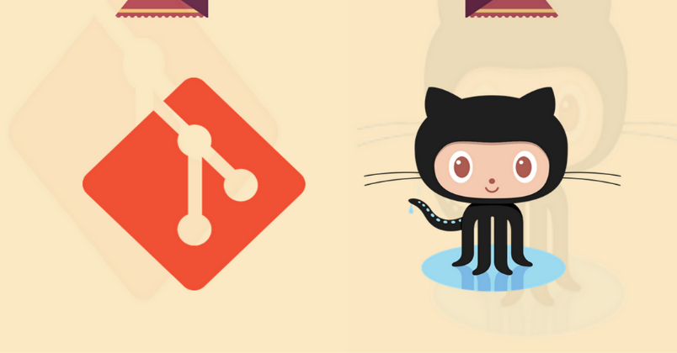
Git and GitHub
Qasir Hassan
MCA 2nd Sem
Roll No: 040
Github.com/sahilqaiser
http://bit.ly/Git_ppt

Slide 2
What is GIT?
GIT is a Version Control System for tracking changes in computer files and coordinating work on those files among multiple people.
~ Wikipedia

Slide 3
Special Features of GIT :
Git is a Distributed VCS.
Git Coordinates work between multiple Authors.
Git keeps track of changes with extra details like Author, Timestamp, change Type etc.
Git can help you revert back any change.
Git can work Offline too.

Slide 4
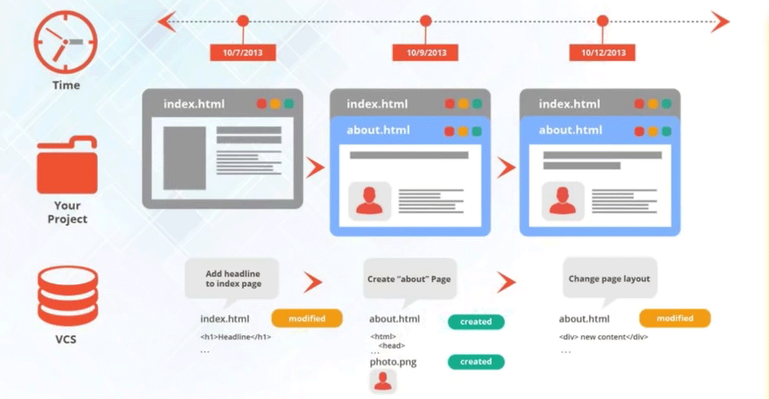
GIT

Slide 5
GIT HOW?
How GIT Keeps Track of Change History :
Git Takes SNAPSHOTS of the Files and Folders (i.e. Project).
We Can visit any of these SNAPSHOTS anytime.
We can Stage File Before SNAPSHOTING them.
SO WHAT ARE SNAPSHOTS???

Slide 6
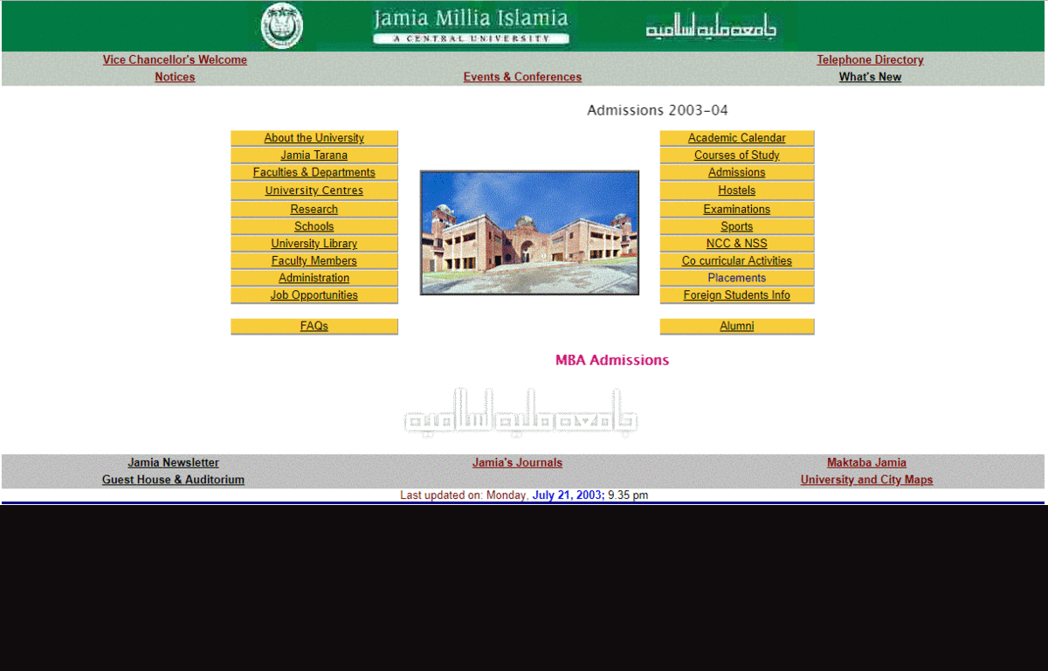

Slide 7
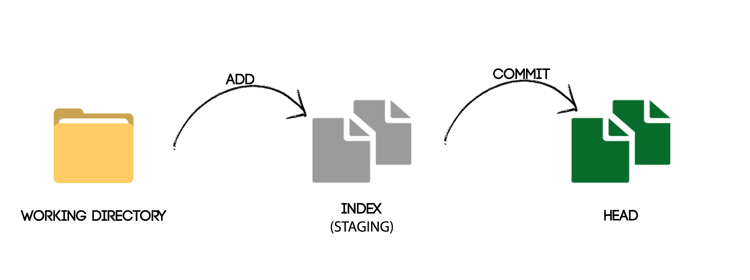
GIT HOW?

Slide 8
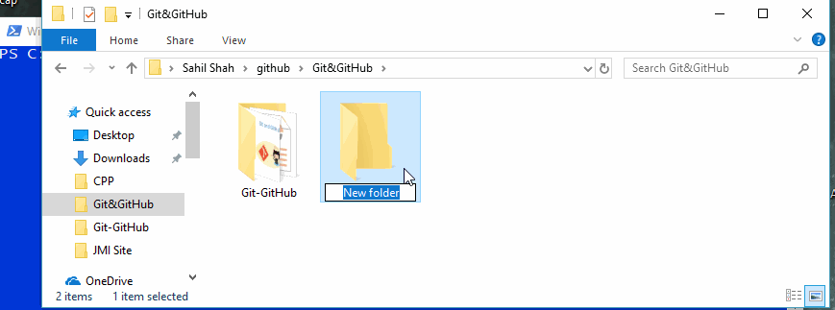
Git Commands
1 - Git init

Slide 9
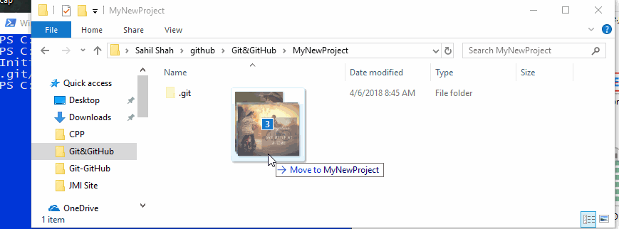
Git Commands
2 - Git add

Slide 10
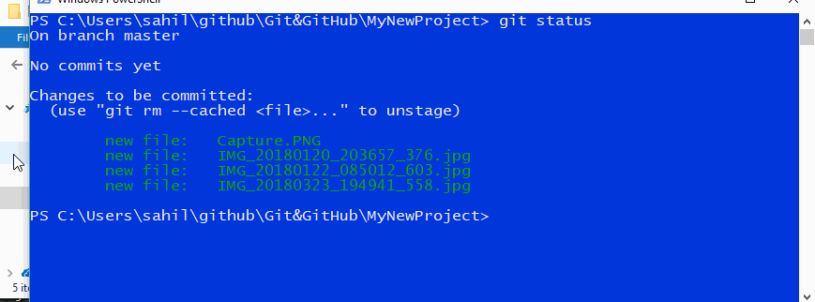
Git Commands
3 – Git COMMIT

Slide 11
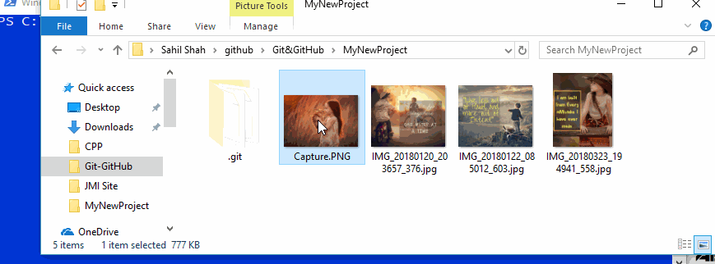
Git Commands
4 – Git Checkout

Slide 12

What is GitHub?

Slide 13
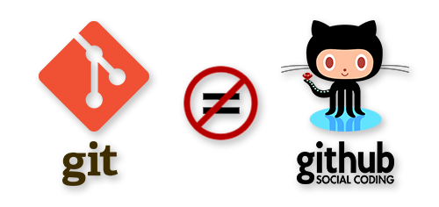
What is GitHub?

Slide 14
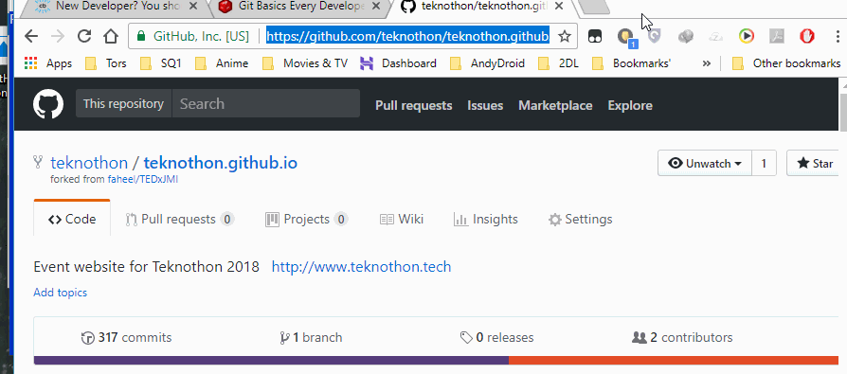
Using GitHub
1 - Git Clone

Slide 15
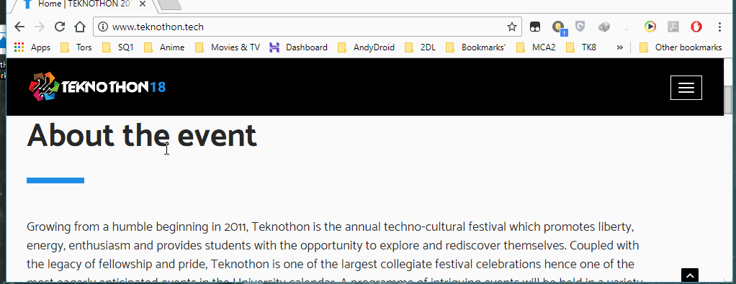
Using GitHub
2 - Fork

Slide 16
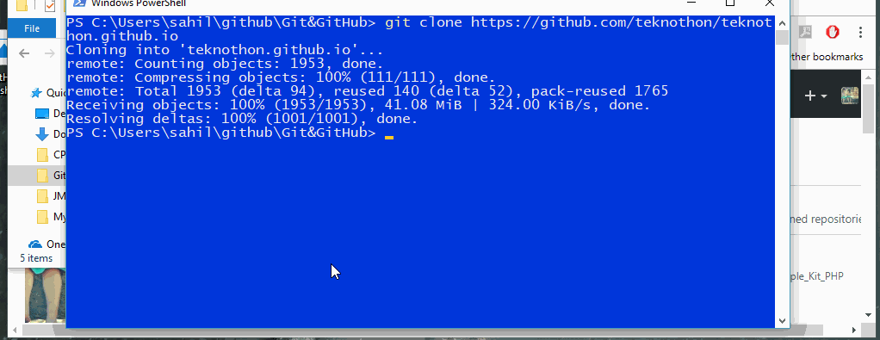
Using GitHub
3 – Git PUSH

Slide 17
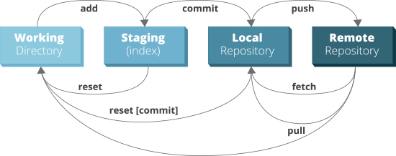
Git Commands

Slide 18
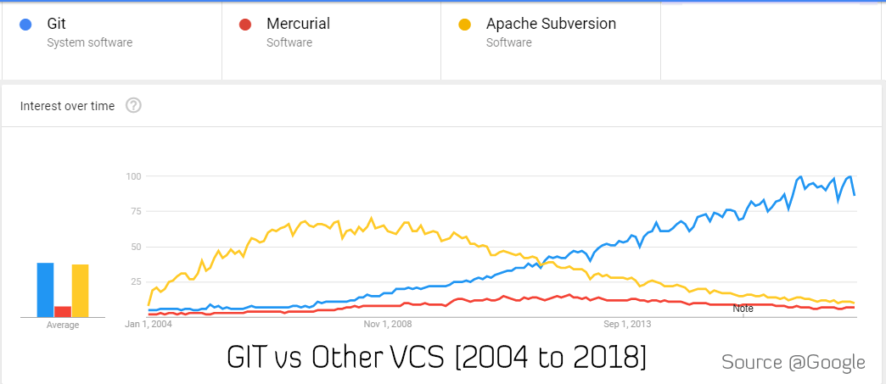
Git vs Other VCS

